Slide 1
Predicting Individual Income
Taaru Chawla

Slide 2
The Data: An Overview
The data was extracted from the 1994 Census Database. It was obtained from the UC Irvine machine learning repository.
It is a relatively small dataset which initially had 32560 rows. Certain rows of the data were excluded due to missing values.
Each row represents information about an individual, such as age, education, family status, occupation, gender, race, country of origin, and the money that the individual makes.

Slide 3
The Data: A Brief Look
Majority of the individuals in the dataset work in the private industry.
Many have HS, or some college, or a Bachelor's degree.
Many are married to a civilian spouse, followed by a large number of unmarried
individuals.
This population is largely white males.
Majority of the individuals are from the US.
The median age is a little below 40.
The median education is 10 years.

Slide 4
Machine Learning
Machine learning is the means by which the computer builds a model based on patterns of existing data to make predictions on unknown data.
In this project, machine learning is used to predict an individual’s income by utilizing the other personal attributes, or features, to make that prediction.
This is considered a supervised learning problem, since we have a goal or a target, which is to predict personal income.
The model will predict whether the income falls in one of two categories or classes::
Less than or equal to $50,000
Greater than $50,000.

Slide 5
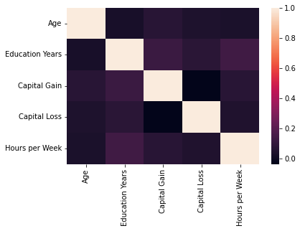
Correlations among continuous variables
There is low correlation between:
Education Years and Capital Gain &
Education and Hours per Week.
No other correlations found in the
continuous variables.

Slide 6
The Predictive Model
For this income classification project, after testing several models, I used a Random Forest Classifier model.
The Random Forest model creates multiple decision trees, or a forest, each from a randomly created subset of data. Each decision tree will make a prediction of the income category and we take the majority vote to come up with a final outcome.
This model gave a high accuracy or predictive value of 0.85, also referred to as testing accuracy.

Slide 7
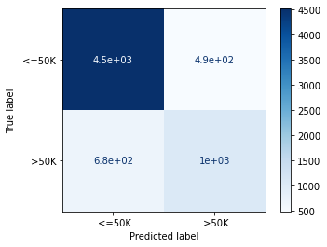
Model Evaluation: Random Forest Model
The model did a better job in predicting whether a person made <=$ 50K. There was an 11% chance that the model misclassified individuals in this income category.
The model did a poor job in predicting whether a person made >$ 50K. There was a 41% chance that the model misclassified individuals in this income category.

Slide 8
Final Recommendations
Of the models tested, the Random Forest Classifier model is the best one based on its testing accuracy.
However, it does better at predicting when the income category is <= $50 K.
The number of individuals in the <=$ 50K category is almost three times as much as the number of individuals in the >$ 50K category. Hence, overall, the model performs well.

